Slide 1
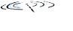

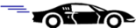

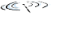






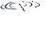
CSC358: Principles of Computer Networks
Lecture 10 – Part 5: TCP Congestion Control
mobile network
4G
national or global ISP
Streaming
video
Skype
IP
local or regional ISP
home network
content
provider
network
HTTP
datacenter
network
Ethernet
TCP
enterprise
network
Erfan Meskar
Winter 2025, University of Toronto, Mississauga

Slide 2
Today’s Lecture
Part 4: Principles of congestion control
Part 5: TCP congestion control
Part 6: Other TCP mechanisms
Nagle’s algorithm and delayed acknowledgments
Part 7: Network Address Translation (NAT)

Slide 3
Idea of TCP Congestion Control and Adapting CWND
Congestion window (cwnd) in congestion control is the equivalent of receiver window in flow control.
cwnd determines the maximum # of unacknowledged bytes sender can have in transit.
TCP sets W = min{congestion window, receiver window}
i.e., send at the rate of the slowest component: receiver or network
Dynamically update the cwnd
Decrease upon losing a packet: backing off
Increase upon success: optimistically exploring

Slide 4
Additive Increase, Multiplicative Decrease
How much to increase and decrease?
Increase linearly, decrease multiplicatively
Additive Increase and Multiplicative Decrease is a necessary condition for stability of TCP.
Intuition: Consequences of over-sized window are much worse than having an under-sized window
Over-sized window: packets dropped and retransmitted
Under-sized window: somewhat lower throughput
Multiplicative decrease
On loss of packet, divide cwnd in half
Additive increase
On success for last window of data, increase cwnd linearly

Slide 5
TCP Implementation of Additive Increase
Src
Data
ACK
Dest
TCP uses bytes, not segments to count:
When ACK is received:

Slide 6
Leads to the TCP “Sawtooth”
AIMD Leads to sawtooth behavior
Window
Loss
halved
t
Later we will see that AIMD is just one of many phases of TCP congestion control.

Slide 7
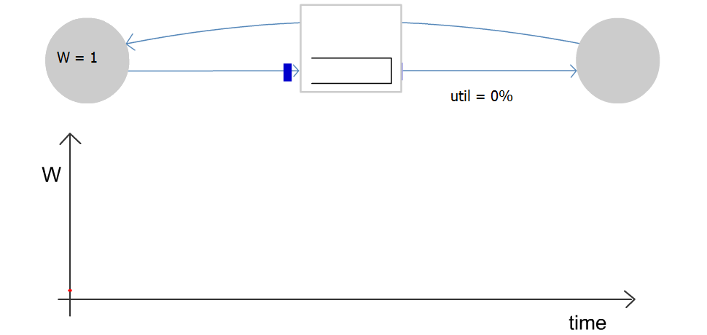
Congestion Window Evolution
Rule for adjusting W
If an ACK is received: W ← W+1/W
If a packet is lost: W ← W/2
Only W packets may be outstanding

Slide 8
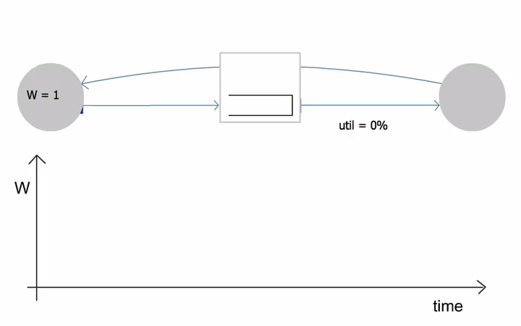
Congestion Window Evolution

Slide 9
Practical Details
Congestion window is represented in bytes, not in packets
Packets have MSS (Maximum Segment Size) bytes
Increasing the congestion window
Increase by MSS on success for last window of data
In practice, increase a fraction of MSS per received ACK
# packets per window: CWND / MSS
Increment per ACK: MSS * (MSS / CWND)
Decreasing the congestion window
Never drop congestion window below 1 MSS

Slide 10
TCP Sending Rate
What is the sending rate of TCP?
Acknowledgement for sent packet is received after one RTT
Amount of data sent until ACK is received is the current window size W
Therefore, sending rate is R = W/RTT
Is the TCP sending rate saw tooth shaped as well?

Slide 11
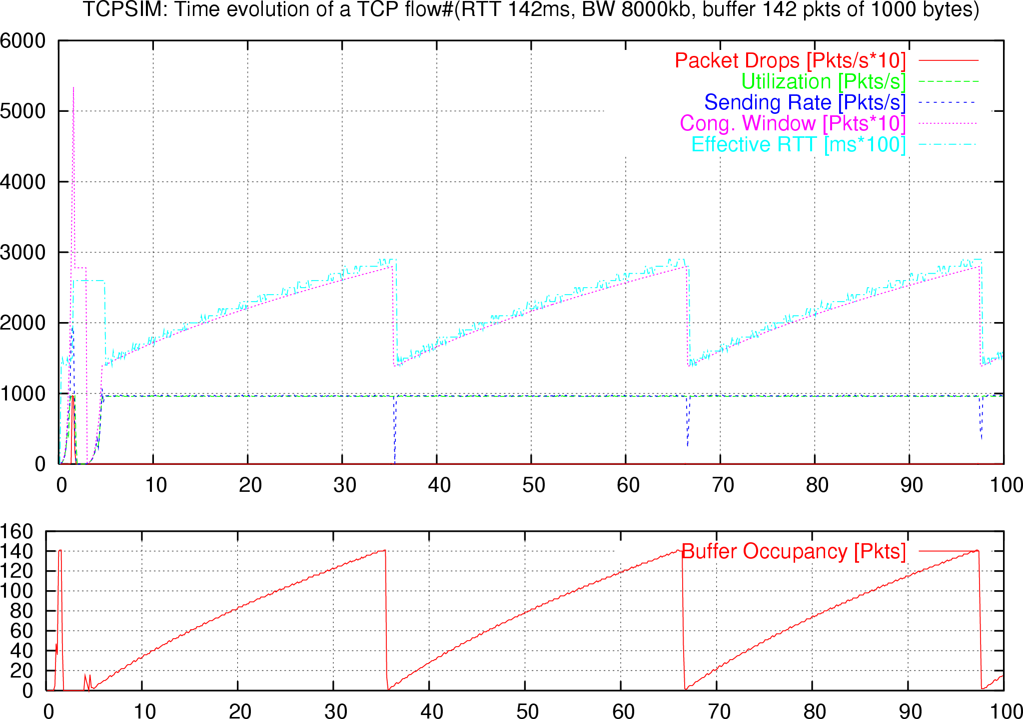
TCP Sending Rate and Buffers

Slide 12
Why Does TCP use AIMD?
Some rate adjustment options: Every RTT, we can
Drastic (i.e., multiplicative) increase or decrease: CWND ← a x CWND
Gentle (i.e., additive) increase or decrease: CWND ← CWND + b
Four options:
AIAD: gentle increase, gentle decrease
AIMD: gentle increase, drastic decrease
MIAD: drastic increase, gentle decrease
MIMD: drastic increase, drastic decrease

Slide 13
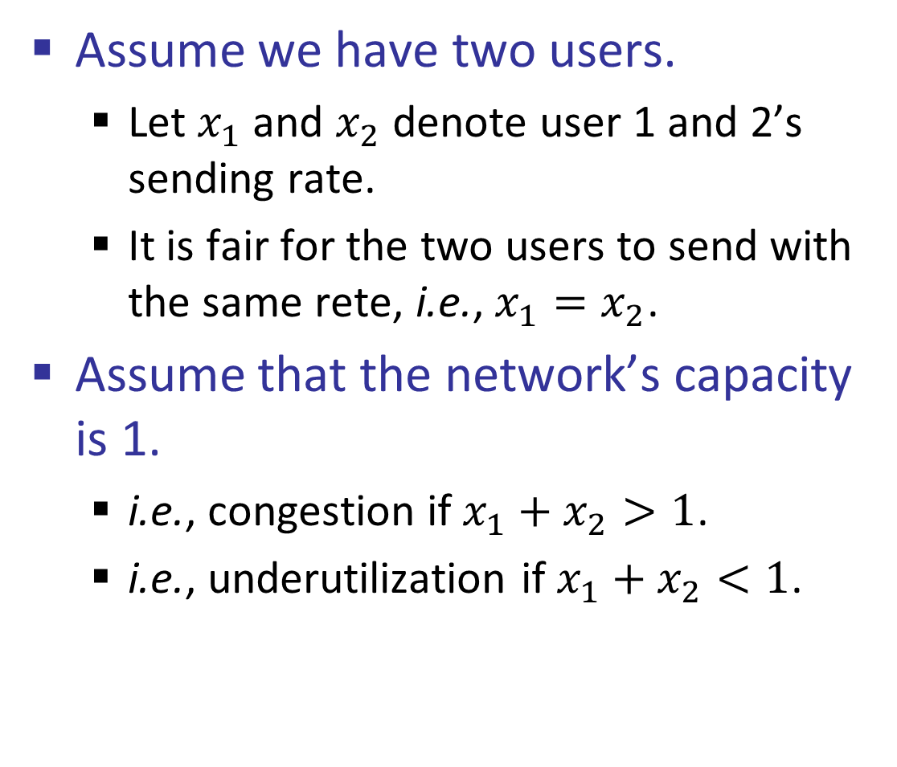
Simple Model of Congestion Control
Assume we have two users.
Let $x_{1}$ and $x_{2}$ denote user 1 and 2’s sending rate.
It is fair for the two users to send with the same rete, i.e., $x_{1}=x_{2}$.
Assume that the network’s capacity is 1.
i.e., congestion if $x_{1}+x_{2}>1$.
i.e., underutilization if $x_{1}+x_{2}<1$.
Fairness line (x₁ =x₂)
1
Efficiency line (x₁+x₂ = 1)
User 2’s rate (x₂)
congested →
← inefficient
User 1’s rate (x₁)
1

Slide 14
Simple Model of Congestion Control
efficiency
line
1
fairness
line
Efficient: x₁+x₂=1
Fair
Congested: x₁+x₂=1.2
(0.2, 0.5)
(0.7, 0.5)
User 2: x₂
(0.5, 0.5)
Inefficient: x₁+x₂=0.7
congested →
(0.7, 0.3)
← inefficient
Efficient: x₁+x₂=1
Not fair
User 1: x₁
1

Slide 15
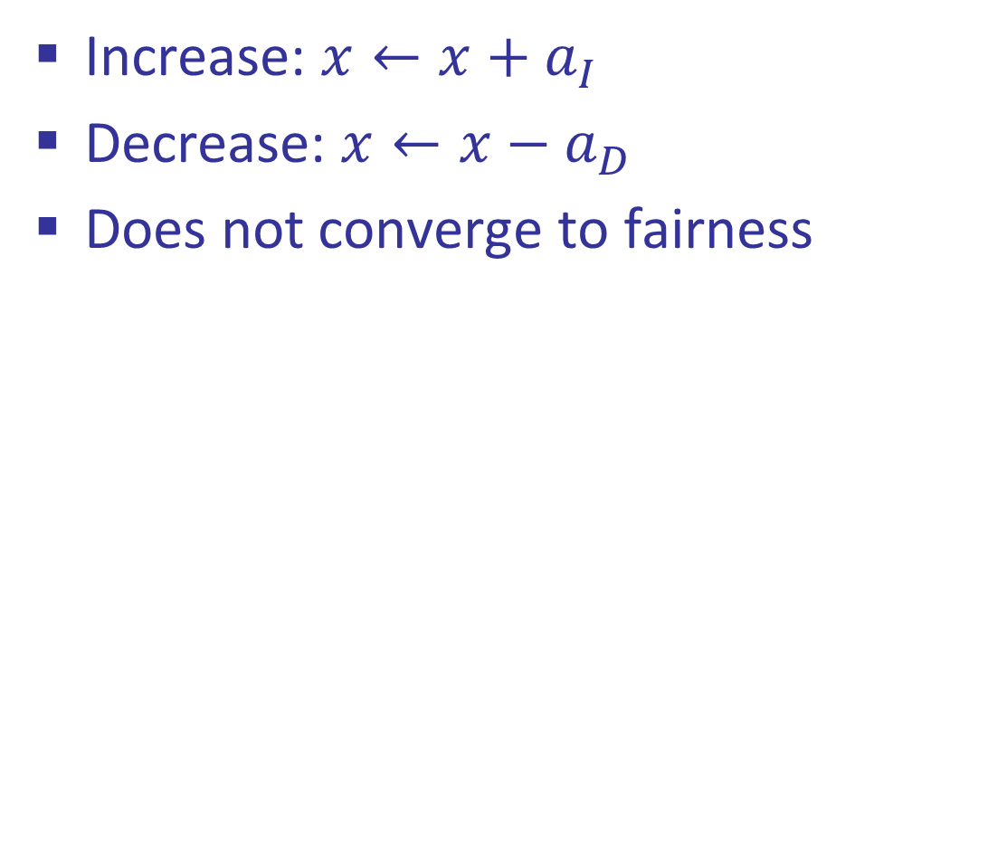
AIAD
Increase: $x←x+a_{I}$
Decrease: $x←x−a_{D}$
Does not converge to fairness
(x₁-a_{D}+a_{I}), x₂-a_{D}+a_{I}))
fairness
line
(x₁,x₂)
User 2: x₂
(x₁-a_{D},x₂-a_{D})
congested →
← inefficient
efficiency
line
User 1: x₁

Slide 16
AIAD Sharing Dynamics
x₁
A
B
x₂
50 pkts/sec
D
E

Slide 17
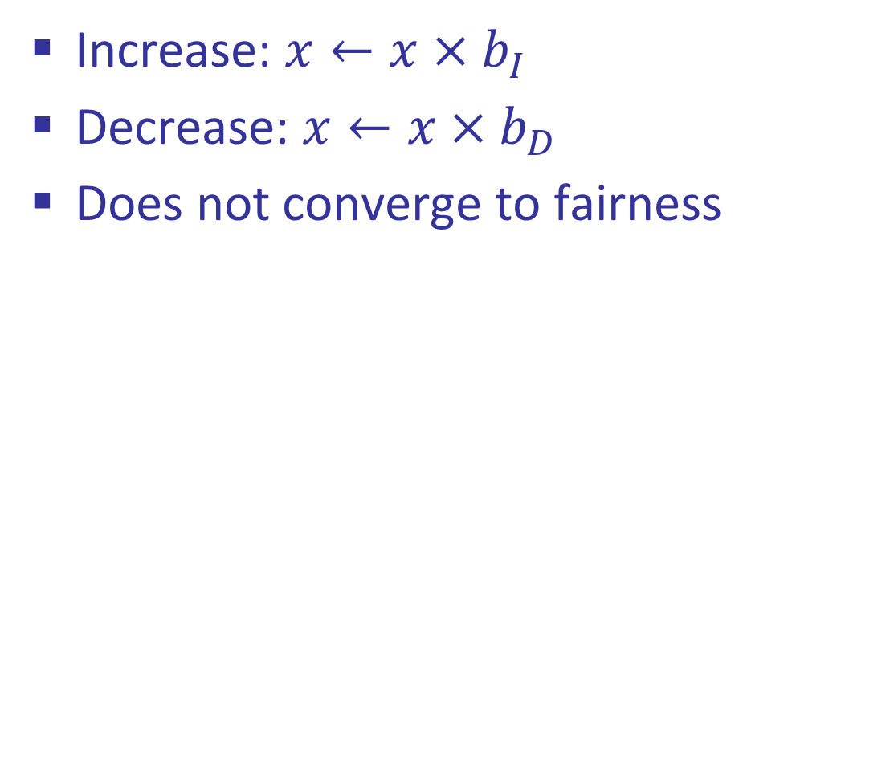
MIMD
Increase: $x←x×b_{I}$
Decrease: $x←x×b_{D}$
Does not converge to fairness
fairness
line
(x₁,x₂)
(b_{I}b_{D}x₁, b_{I}b_{D}x₂)
User 2: x₂
(b_{d}x₁,b_{d}x₂)
congested →
← inefficient
efficiency
line
User 1: x₁

Slide 18
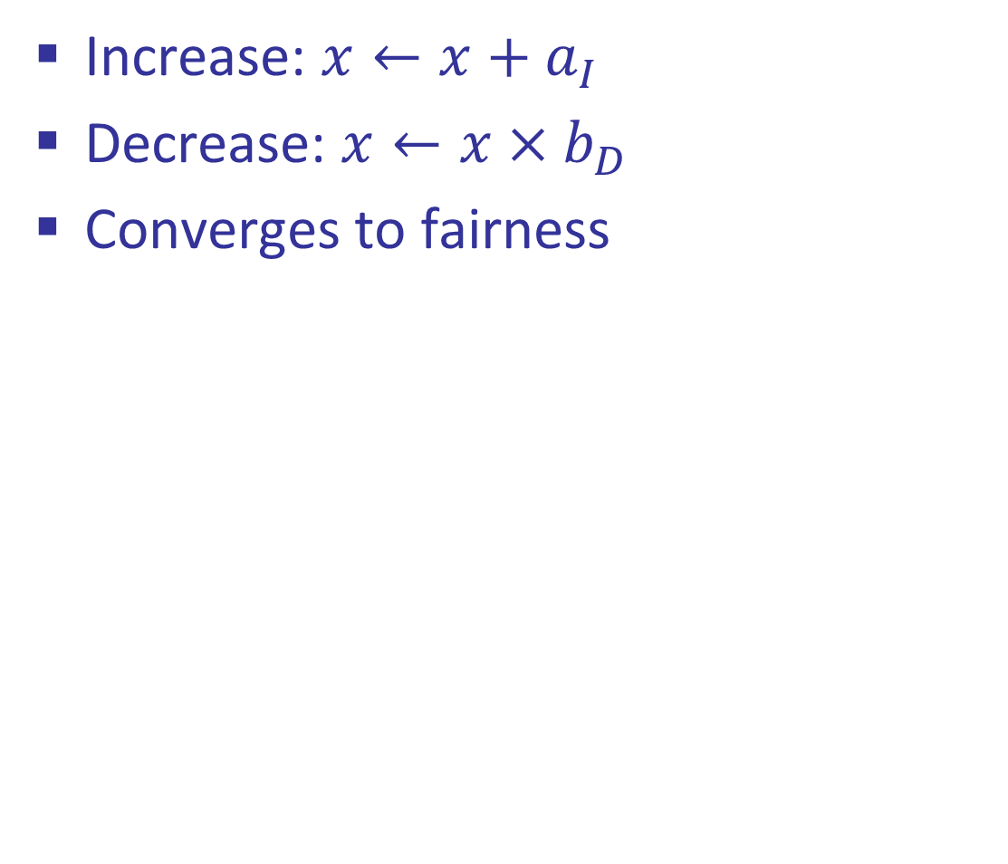
AIMD
Increase: $x←x+a_{I}$
Decrease: $x←x×b_{D}$
Converges to fairness
fairness
line
(x₁,x₂)
(b_{D}x₁+a_{I}, b_{D}x₂+a_{I})
User 2: x₂
(b_{D}x₁,b_{D}x₂)
congested →
← inefficient
efficiency
line
User 1: x₁

Slide 19
AIMD Sharing Dynamics
x₁
A
B
x₂
50 pkts/sec
D
E
Rates equalize → fair share

Slide 20
Getting Started
When TCP starts, it needs to start with a small cwnd to avoid overloading the network.
Initially, CWND is 1 MSS
So, initial sending rate is MSS/RTT
That could be very wasteful
Might be much less than the actual bandwidth
Linear increase takes a long time to accelerate
That’s why TCP uses Slow-start phase (slow-start phase is implemented to achieve “fast start.” The name is misleading)
cwnd
But, could take a long time to get started!
t

Slide 21
“Slow Start” Phase
Slow-start phase (really “fast start”)
Sender starts at a slow rate (hence the name)
… but increases the rate exponentially instead of additive increase
… until the first loss event

Slide 22
Slow Start in Action
Double CWND per round-trip time = Increase CWND by 1 MSS for each ACK received
1
2
3
4
8
Src
D
D
D
A
A
D
D
D
D
A
A
A
A
A
Dest

Slide 23
Slow Start and the TCP Sawtooth
Window
Loss
Exponential “slow start”
t
Why is it called slow-start? Because TCP originally had
no congestion control mechanism. The source would just start by sending a whole window’s worth of data.

Slide 24
There are Two Kinds of Loss in TCP
Triple duplicate ACK
Packet n is lost, but at least three packets after n arrived
Receiver sends duplicate acknowledgments
… and the sender retransmits packet n quickly
Do a multiplicative decrease and keep going
Timeout
Packet n is lost and detected via a timeout
e.g., because all packets in flight were lost
So, better to start over with a low CWND

Slide 25
Slow-Start Restart After Timeout
Window
timeout
Start additive increase as soon as cwnd reaches half of previous cwnd.
Slow start in operation until it reaches half of previous cwnd.
t
Go back to cwnd=1
Slow-start restart: Go back to CWND of 1, but take advantage of knowing the previous value of CWND.

Slide 26
Repeating Slow Start After Idle Period
Suppose a TCP connection goes idle for a while
e.g., Telnet session where you don’t type for an hour
Eventually, the network conditions change
Maybe many more flows are traversing the link
e.g., maybe everybody has come back from lunch!
Dangerous to start transmitting at the old rate
Previously-idle TCP sender might blast the network
… causing excessive congestion and packet loss
So, some TCP implementations repeat slow start
Slow-start restart after an idle period

Slide 27
The March of Congestion Control Mechanisms
DUAL
EBCC
Binomial
Reminis
CARD
SACK
Westwood
FAST
PCC
C2TCP
Orca
?
DECbit
Vegas
Eifel
Veno
Compound
LEDBAT
Verus
BBR
DeepCC
?
Tahoe
Reno
New Reno
BIC
H-TCP
Cubic
PRR
Sprout
PCC-Vivace
?
1980s
1990s
2000s
2010s
2020s
GPS
RED
ECN
CHOKe
XCP
DCTCP
PDQ
FCP
ABC
?
?
WFQ
BLUE
AVQ
RCP
VCP
DeTail
pFabric
NATCP
?
CoDel
NACubic
?

Slide 28
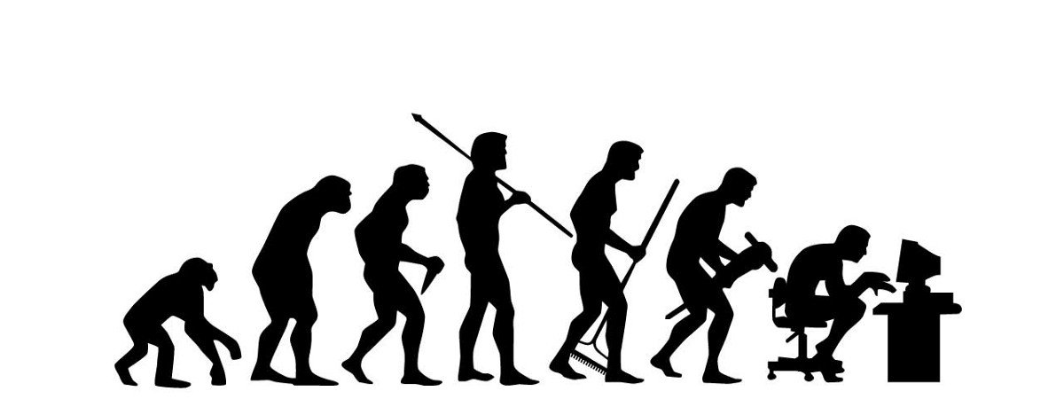

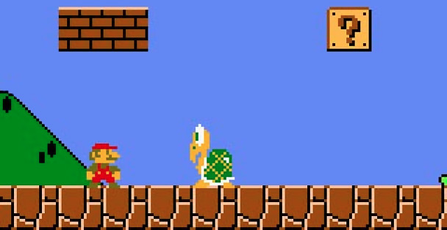

Why is that and Why does It Matter?
Stadia
Discontinued!

Slide 29
Deployed TCP CC schemes . . .
The latest Linux Kernel alone includes more than 15 different TCP CC flavors!
TCP Cubic (the default TCP)
Vegas
BBR
TCP Reno
BIC
CDG
DCTCP
Westwood
Highspeed TCP
Illinois
Veno
…
You can change your CC algorithm. e.g., in Linux:
sudo sysctl -w net.ipv4.tcp_congestion_control=“vegas"

Slide 30
TCP Cubic (2008)*
Less wasted bandwidth due to fast ramp up
Stable region and slow acceleration help maintain fairness
Slowly accelerate to probe for bandwidth
CUBIC Function
Timeout
cwnd_{max}
cwnd
Stable
Region
Slow Start
Fast ramp up
* Won’t be covered on the final exam

Slide 31
Today’s Lecture
Principles of congestion control
Learning that congestion is occurring
Adapting to alleviate the congestion
TCP congestion control
Additive-increase, multiplicative-decrease
Slow start and slow-start restart
Related TCP mechanisms
Nagle’s algorithm and delayed acknowledgments
Network Address Translation (NAT)

Slide 32
Other TCP Mechanisms
Nagle’s Algorithm and Delayed ACK

Slide 33
Motivation for Nagle’s Algorithm
Interactive applications
Telnet, ssh and rlogin
Generate many small packets (e.g., keystrokes)
Small packets are wasteful
Mostly header (e.g., 40 bytes of header, 1 byte of data)
Appealing to reduce the number of packets
Could force every packet to have some minimum size
… but, what if the person doesn’t type more characters?
Need to balance competing trade-offs
Send larger packets
… but don’t introduce much delay by waiting

Slide 34
Nagle’s Algorithm
Wait if the amount of data is small
Smaller than Maximum Segment Size (MSS)
And some other packet is already in flight
i.e., still awaiting the ACKs for previous packets
That is, send at most one small packet per RTT
… by waiting until all outstanding ACKs have arrived
Influence on performance
Interactive applications: enables batching of bytes
Bulk transfer: transmits in MSS-sized packets anyway
ACK
vs.

Slide 35
Motivation for Delayed ACK
TCP traffic is often bidirectional
Data traveling in both directions
ACKs traveling in both directions
ACK packets have high overhead
40 bytes for the IP header and TCP header
… and zero data traffic
Piggybacking is appealing
Host B can send an ACK to host A
… as part of a data packet from B to A

Slide 36
TCP Header Allows Piggybacking
Source port
Destination port
Sequence number
Flags:
SYN
FIN
RST
PSH
URG
ACK
Acknowledgment
HdrLen
0
Flags
Advertised window
Checksum
Urgent pointer
Options (variable)
Data

Slide 37
Example of Piggybacking
A
B
Data
B has data to send
Data+ACK
Data
ACK
B doesn’t have data to send
Data
A has data to send
Data + ACK

